Slide 1


Design and Development of Non-Invasive Device for Diagnosis of Hemoglobinopathies
Ahemad Khan Pathan (180107004)
Guide : Prof. Dipankar Bandyopadhyay
Prof. Resmi Suresh
Department of Chemical Engineering, IIT Guwahati

Slide 2
Content :
Hemoglobinopathies
Diagnosis Methods :
Complete Blood Count (CBC)
Electrophoresis
Isoelectric Focusing
Susruta : Smartphone App for Diagnosis of Different Anemias
Objective and Hypothesis
References

Slide 3
Hemoglobinopathies
Abnormal Hemoglobins:
HbS (Sicke-Cell Anemia)
In HbS, glutamate at sixth position of β-chain is replaced by valine represented as (Glu β6 →Val). In this RBCs turns into crescent like shape. At low oxygen concentration.
HbD Hemoglobin
In this substitution of glutamine in place of glutamate in the 121st position of β-chain. HbD variants are further identified by different places.
E.g. HbD (Punjab), HbD (Los Angeles).
HbC Disease (Cooley’s Hemoglobin)
It is characterized by substitution of glutamate by lysine in the sixth position of β-chain. HbC disease occurs only in blacks. Both homozygous and heterozygous individuals of HbC disease are
known.
HbE Hemoglobin
HbE is characterized by replacement of glutamate by lysine at 26th position of β-chain. This is the most common abnormal hemoglobin after HbS. About 10% of the population in South-East Asia (Bangladesh, Thailand, Myanmar) suffer from HbE disease and in India, it is prevalent in West Bengal.

Slide 4
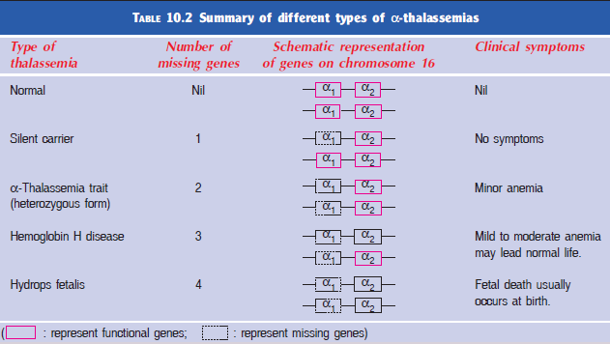
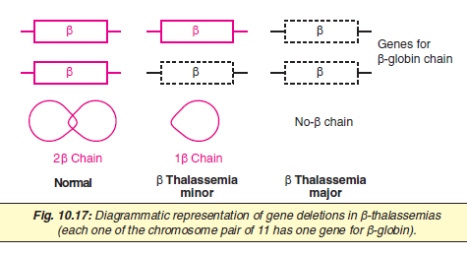
Hemoglobinopathies
Thalassemia : Defect in Globin Chain Production
α-Thalassemia :
α-Thalassemias are caused by a decreased synthesis or total absence of α-globin chain of Hb. There are four copies of α-globin gene, two on each one of the chromosome 16.
β-Thalassemia :
Decreased synthesis or total lack of the formation of β-globin chain .The production of β-globin chain continues to be normal, leading to the formation of a globin tetramer (α4) that precipitate causing premature death of erythrocytes.
Source : Biochemistry : U Satyanarayana

Slide 5
Diagnosis Methods
Complete Blood Count :
Table 31 - 2
Ganong's Review of Medical Physiology
The Complete blood count (CBC) and blood film are important primary screening tests in haemoglobinopathy diagnosis. Of particular interest are the red cell indices: red count (RBC), hemoglobin (Hb), mean cell volume (MCV) and mean cell hemoglobin (MCH). These are essential in thalassemia diagnosis.
Classically the picture in thalassemia trait is described as one with a mildly raised RBC, normal Hb and reduced MCV and MCH; these are referred to as thalassemic red cell indices. Co-inheritance of alpha and beta thalassemia may cause the red cell indices to normalize, as excess alpha chains are partly responsible for the pathology in beta thalassemia.
Mentzer Index (MI) = MCV / RBC
If MI < 13 likely to be thalassemic carrier
If MI > 13 likely to be iron-deficiency anemia
It was proposed by William C. Mentzer in 1973 for the differentiation of above mentioned anemias.

Slide 6
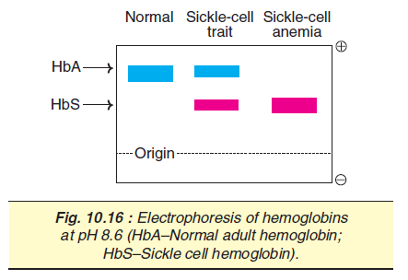
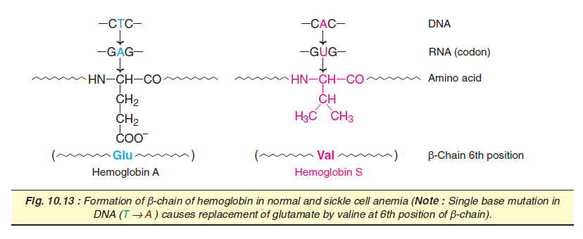
Diagnosis Methods
Electrophoresis :
Electrophoresis is the motion of charged particles relative to a fluid under the influence of a uniform Electric Field.
Electrophoresis enables the separation of different hemoglobins on the basis of charge. Electrophoretic separation at two pH values, alkaline and acid, enables identification of common hemoglobin structural variants A/F/S/D/C/E/O-Arab, H etc.
When subjected in alkaline medium (pH 8.6), sickle-cell hemoglobin (HbS) moves slowly towards anode (positive electrode) than does adult hemoglobin (HbA). The slow mobility of HbS is due to less negative charge, caused
by the absence of glutamate residues that carry negative charge.
Source : Biochemistry : U Satyanarayana

Slide 7
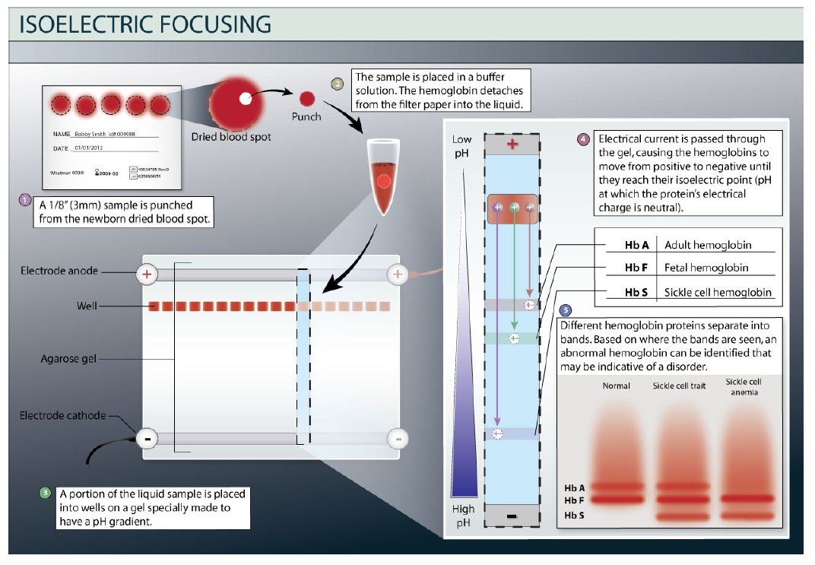
Diagnosis Methods
Isoelectric Focusing :
IEF separates proteins in a gel medium that has a pH gradient consisting of ampholytes (zwitterions). When a high voltage is applied, narrow buffered zones are created with stable, but slightly different pHs.
Slower moving proteins migrate through these zones and stop at their individual isoelectric points (pI).
At the pI, the charge of the hemoglobin becomes zero and ceases to migrate. The hemoglobin migration order of IEF is similar to alkaline electrophoresis.

Slide 8
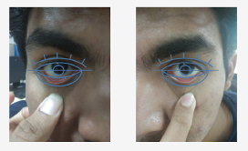
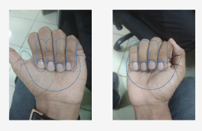
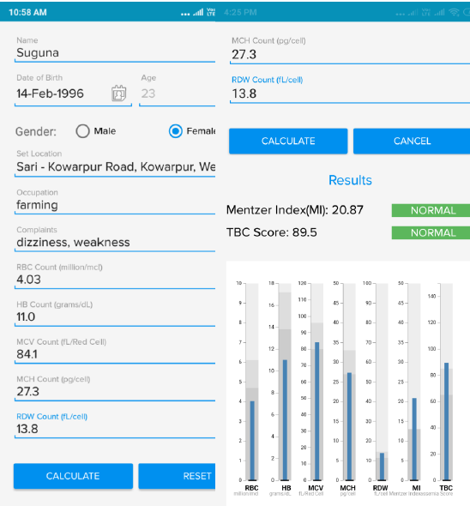
Diagnosis Methods
Susruta : Smartphone App for
Diagnosis of Different Anemias :
Artificial Neural Network (ANN) with Machine Learning and Deep Learning (ML/DL) on 60,283 labelled common blood counts (CBC) and High Performance Liquid Chromatography (HPLC) data collected over 8 years by a teaching hospital in Kolkata for Beta-TT screening;
Image processing and computer vision techniques to interpret hemoglobin content in blood through non-invasive analysis of conjunctiva and nailbed smartphone images.
The app does two main functions, namely: • Diagnosis of Beta-Thalassemia carriers and patients using the automated CBC. Diagnosis of the iron deficiency anemia (IDA) through non-invasive techniques.

Slide 9
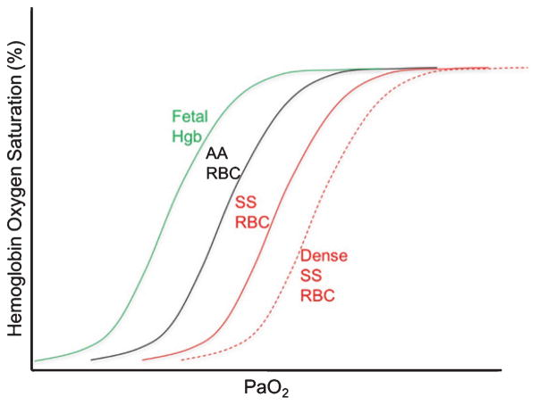
Objective and Hypothesis
Hypothesis :
Since the oxygen affinity is different for different variants, hence the oxygen saturation level as well will be different. Hence when the pulse co-oximeter is used the patients with different hemoglobin variants will fall under different brackets of the saturation values.
Also other parameters such as temperature can be considered for the classification as there will be different values of saturation under different body temperatures regulating the oxygenation and de-oxygenation of hemoglobin.

Slide 10
References
Biochemistry : U Satyanarayana, 2013 Edition
Ganong's Review of Medical Physiology, 26th Edition
Guyton and Hall Textbook of Medical Physiology, 13th Edition
https://www.khanacademy.org/science/biology/
https://www.who.int/vmnis/anaemia/prevalence/summary/

Slide 11
Thankyou

